Slide 1
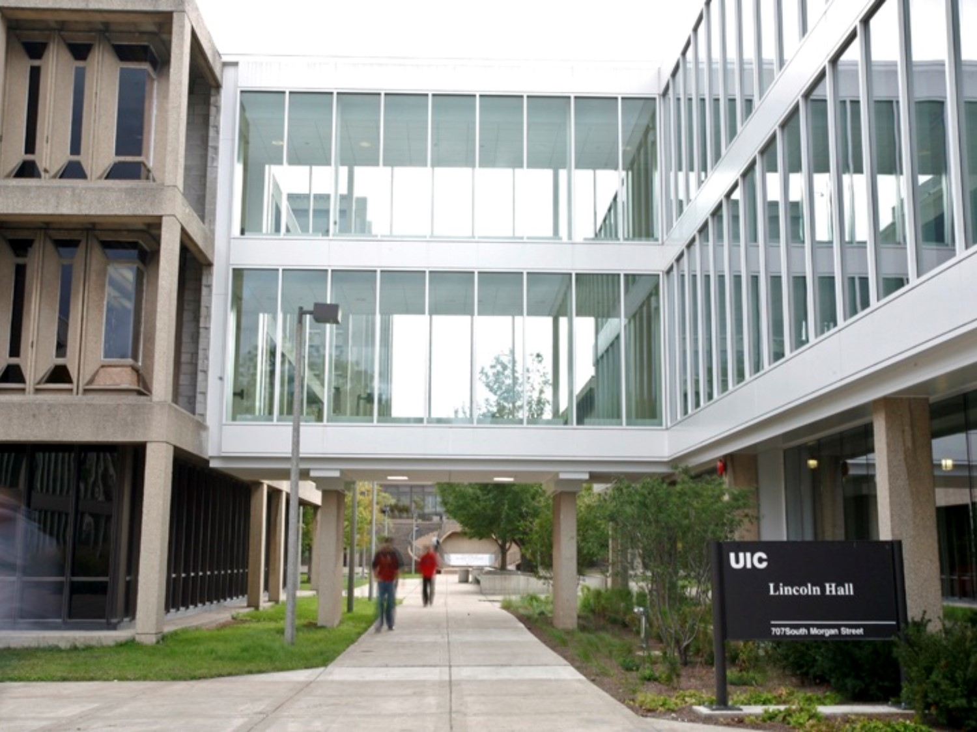

Report Retrieval Options
2016 BRINGING ADMINISTRATORS TOGETHER CONFERENCE
April 14, 2016
10:15am-11:15am
1:30pm-2:30pm

Slide 2

Workshop Presenters
Sherri Faith
Associate Director, University Accounting & Financial Reporting
slfaith@uillinois.edu
Jerry Myers
Functional Area Coordinator for Finance, Administrative Information Technology Services
jdmyers6@uillinois.edu

Slide 3
Please …
Turn off cell phones.
Avoid side conversations.
Hold questions until the end.
Sign the attendance roster.
Complete the evaluation at the end of the workshop.

Slide 4

Workshop Objectives
Identify the different reporting and data tools available
Determine when and why to use each option

Slide 5
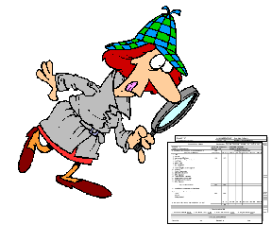
View Direct
Static month-end standard finance reports
HR/Pay reports
FOAPAL Hierarchy reports

Slide 6

Standard Financial Reports
Operating Ledger
Revenue/Expense/Transfer Transactions
Revenue/Expense/Transfer Detail Statement
General Ledger
Asset/Liability Transactions
Asset/Liability Detail Statement
Revenue/Expense/Transfer Summary Statement
Revenue/Expense/Transfer Detail Statement Inception to Date
Revenue/Expense/Transfer Summary Statement Inception to Date
Encumbrance Balances
Asset/Liability Summary Statement

Slide 7
HR/Pay Reports
Payroll Expense by Person Pay Period
Payroll Expense by Person Month End
Payroll Encumbrance by Person Pay Period
Payroll Encumbrance by Person Month End
Payroll Encumbrance by Person MYE Year End

Slide 8

FOAPAL Hierarchy Reports
Account Index Report
Account Hierarchy Report
Activity Code Report
Fund Hierarchy Report
Location Hierarchy Report
Organization Hierarchy Report
Program Hierarchy Report

Slide 9
Why Use View Direct?
Quick access to print reports by organization code for reconciliation
Only one or few organization codes
Few self-supporting funds
Don’t distribute by CFOP to PIs, Department Head, etc.

Slide 10
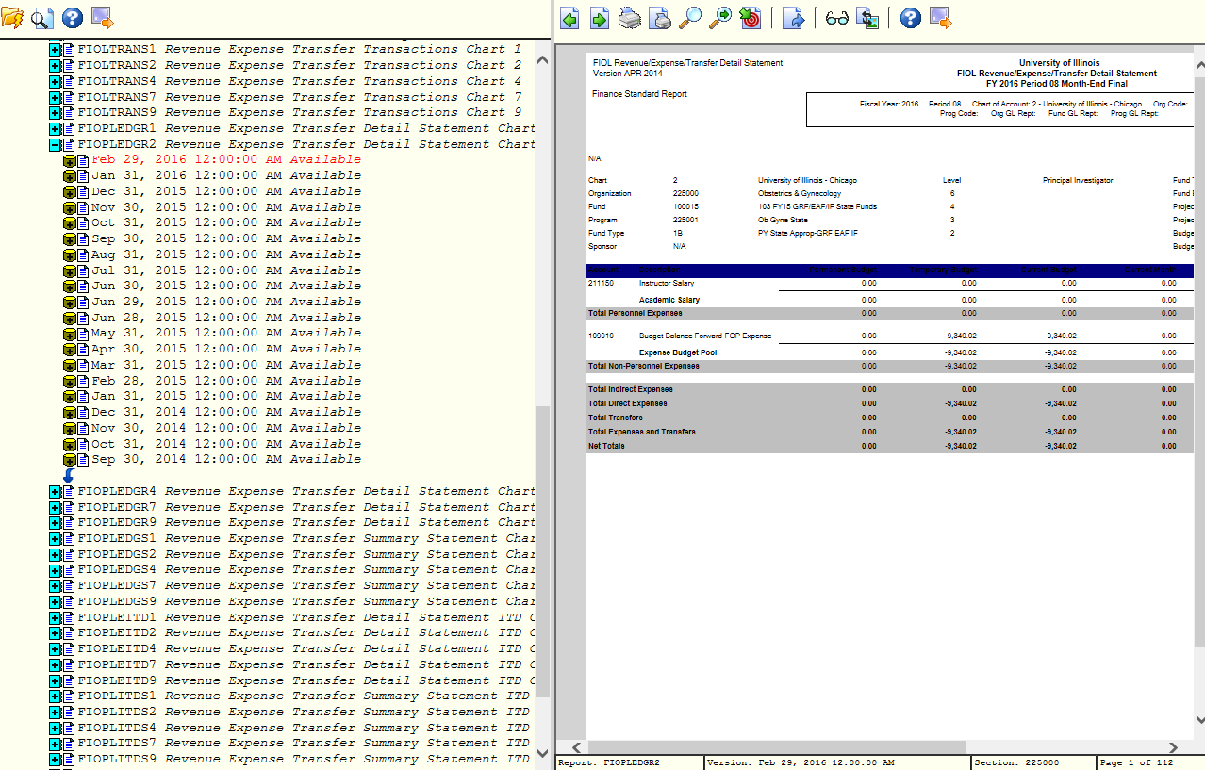
https://docdirectpweb.admin.uillinois.edu/ddrint/servlet/ddrint

Slide 11

Enterprise Data Delivery & Information Environment
Standard Finance reports
Operating Ledger reports
General Ledger reports
Fixed Asset reports
Accounts Receivable
Grants
Purchasing

Slide 12

Operating Ledger Reports
Summary reports
  College Dept Fund Type Summary
  Operating Ledger Summary
YTD Transaction Statements
Operating Statement Rollups
Misclassified FOAPAL report
MultiFund Management Reports
Operating Ledger by Org

Slide 13

General Ledger Reports
Fund Type Summary
General Ledger Department Fund Summary
General Ledger Fund Summary

Slide 14



Fixed Asset Reports
Fixed Asset by Org
Monthly Activity by Chart and Organization
Commodity Search
Fixed Asset Pending List
Location

Slide 15
A/R, Grants & Purchasing Reports
Accounts Receivable
Account Detail Reports
Grants
Grant Detail
Purchasing
Departmental Requisition
Account Detail By Account
Account Detail By Detail Category Code
Account Detail By Detail Code
Open Invoice Reports
Open Invoice By Account
Open Invoice By Category Code
Open Invoice By Detail Code

Slide 16
Why Use EDDIE?
Many organization or fund codes
Choice of parameters
Can export report to excel
Can save report parameters to favorites

Slide 17
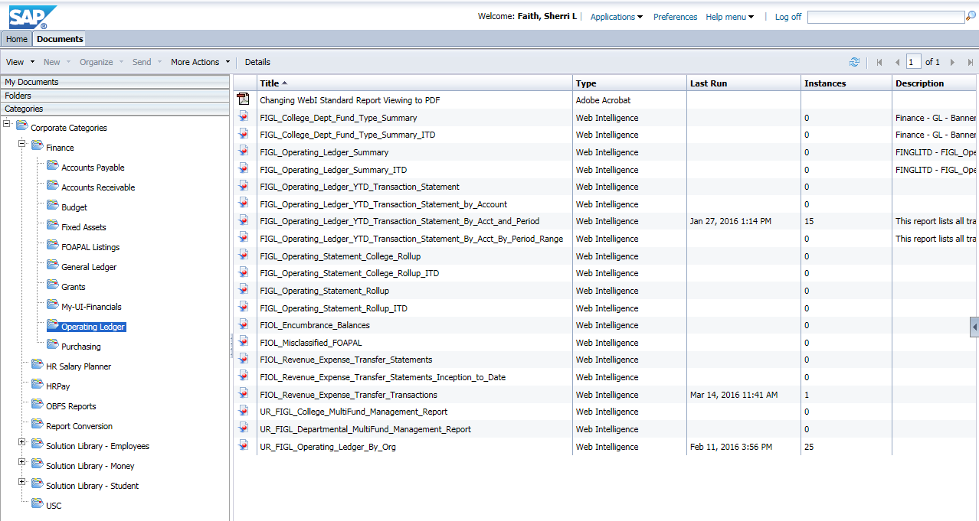
https://eddie.ds.uillinois.edu/

Slide 18
What is My-UI-Financials?
Dashboard view of CFOP within viewing privileges
Budget Balance Available
View details by account code, transactions
Reports
Operating Ledger Standard Finance Reports
HR\Pay Reports

Slide 19

Why Use My-UI-Financials?
Easy to use, intuitive interface
Finance and payroll reports in one place
No experience with View Direct or EDDIE needed
Easy way to distribute reports to PIs, Department Heads, etc.

Slide 20
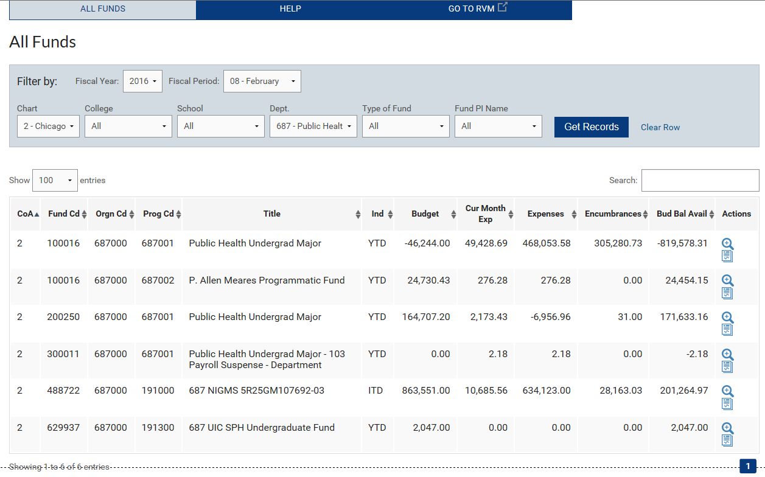
https://myuifinancials.uillinois.edu/myFi/

Slide 21
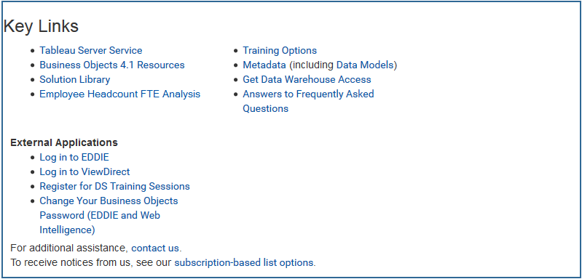
Resources from DS Website
https://www.aits.uillinois.edu/services/reports_and_data
https://answers.uillinois.edu/ua/

Slide 22
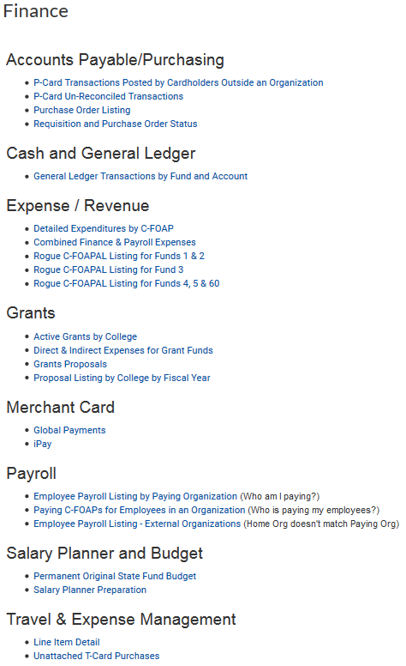
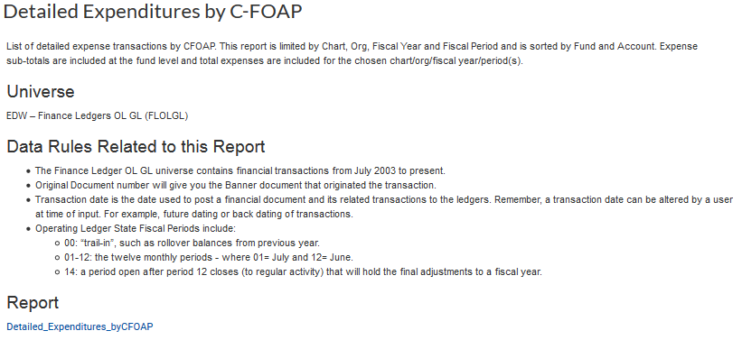
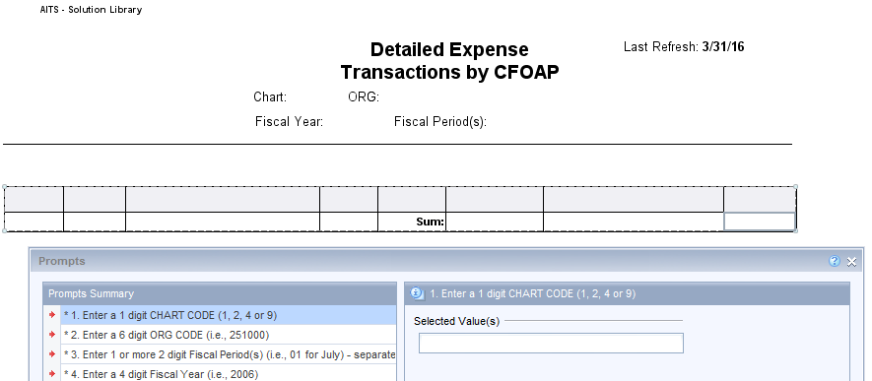
What is Solution Library?

Slide 23
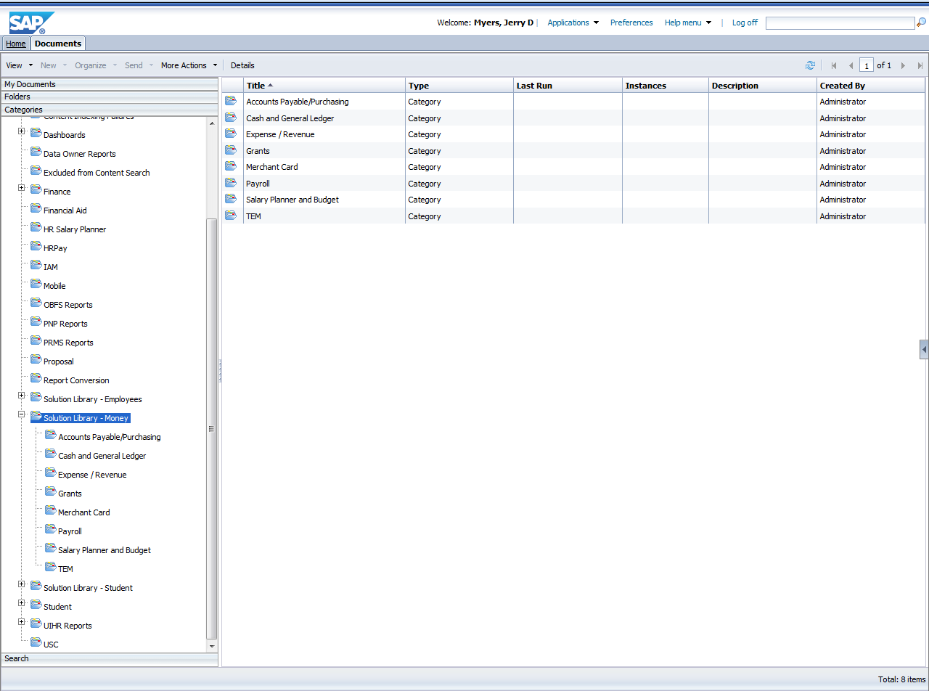
Solution Library

Slide 24

What is Web Intelligence?
Web Intelligence is the BusinessObjects tool for ad hoc analysis.
Available in Web-based (via EDDIE) and desktop versions.
Allows for specific use reporting.
Great for researching transactions and finding greater details.

Slide 25
Why use Solution Library or WebI?
Allows access to data in the Data Warehouse Environment via Universes.*
Data sources can be combined including multiple universes and Excel data.
Query filters can be modified and customized and reports can be scheduled to run and distribute.
Report Writing Training and Practice Labs are open monthly.
*Addition security access may be required.

Slide 26
What is START myResearch?
START (Systemwide Tools for Administration of Research and Training) is the grants management software leveraging open source (Kuali Coeus) as well as University of Illinois developed software. myResearch is the Principal Investigator (PI) portal that will integrate and display information from a number of different university systems, giving faculty access to the information they need to prepare, submit, route, and manage their grants.
The myResearch Portal is an online system designed to provide a central point for both faculty members and designated staff to access sponsored research portfolio information.

Slide 27
Why use myResearch?
The myResearch Portal provides quick and easy access to information regarding a principal investigator’s sponsored research portfolio, including information regarding pending proposals, negotiations, active awards, closed awards, non-funded proposals, and the financial status of active awards.
https://myresearch.uillinois.edu/home/
https://myresearch.uillinois.edu/piPortal/

Slide 28
Additional Resources
OBFS Training Center
(Job Aids, On-line and instructor-lead courses) https://www.obfs.uillinois.edu/training/
Decision Support Training
  (On-line and instructor-lead courses) https://www.aits.uillinois.edu/services/reports_and_data/help_and_training/training/
General Search )
https://answers.uillinois.edu/

Slide 29

Workshop Summary
After this workshop you can
  Identify the different reporting and data tools available
  Determine when and why to use each option

Slide 30
Questions / Concerns?

